Slide 1

CSS Preprocessors
Lesson 10 – Mr. Minh Sang

Slide 2
Objectives
Develop CSS code using preprocessors like Less and Sass

Slide 3

Less and Sass

Slide 4
CSS
CSS is great for defining styles and repeatedly applying them to various HTML elements
CSS is limited when it comes to features like defining variables, nesting selectors, expressions, functions…
Maintainability suffers

Slide 5
CSS Preprocessors
Several popular:
Less
Sass (Syntactically Awesome Style Sheets), and Scss (Sassy CSS) syntax examined in this course
Stylus
All are compiled into traditional CSS syntax automatically before use in a web page
We will examine Less and Sass briefly

Slide 6
Typical CSS Preprocessors Features
Variables
Nesting selectors
Mixins
Functions & Expressions

Slide 7
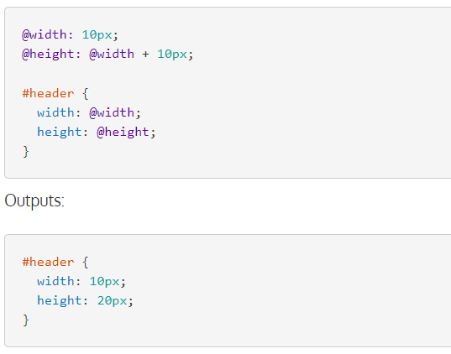
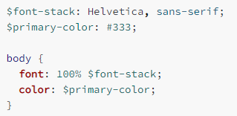
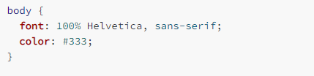
Variables
Outputs:

Slide 8
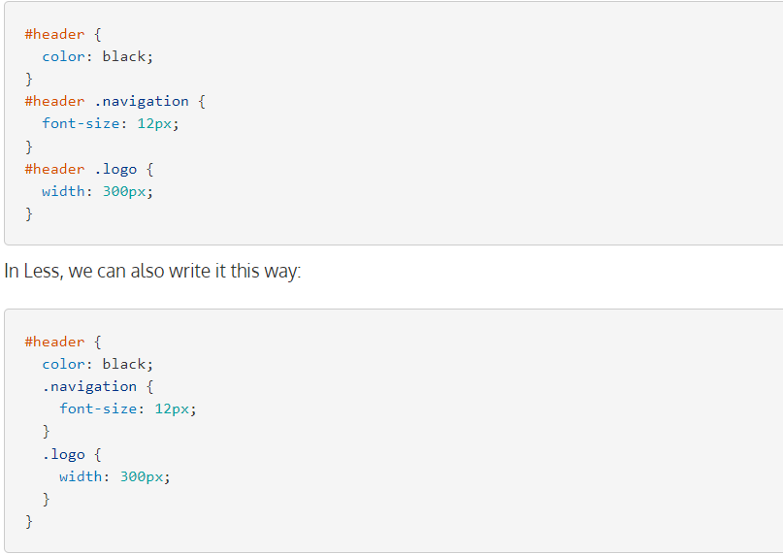
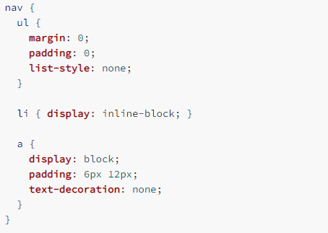
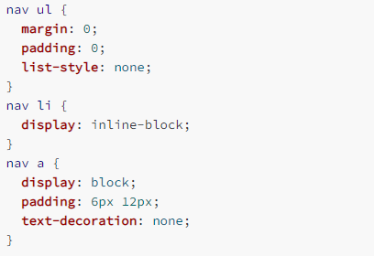
Nesting

Slide 9

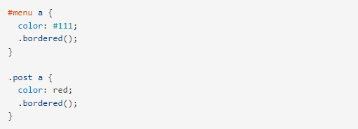
Mixins - less
The properties of the .bordered class will now appear in both #menu a and .post a.

Slide 10
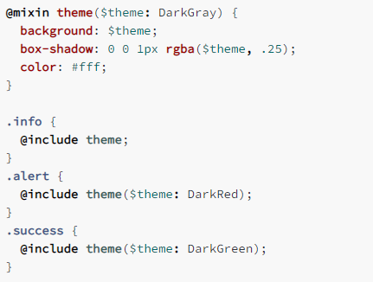
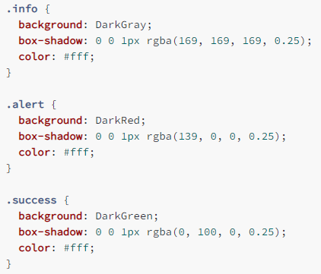
Mixins - Scss

Slide 11
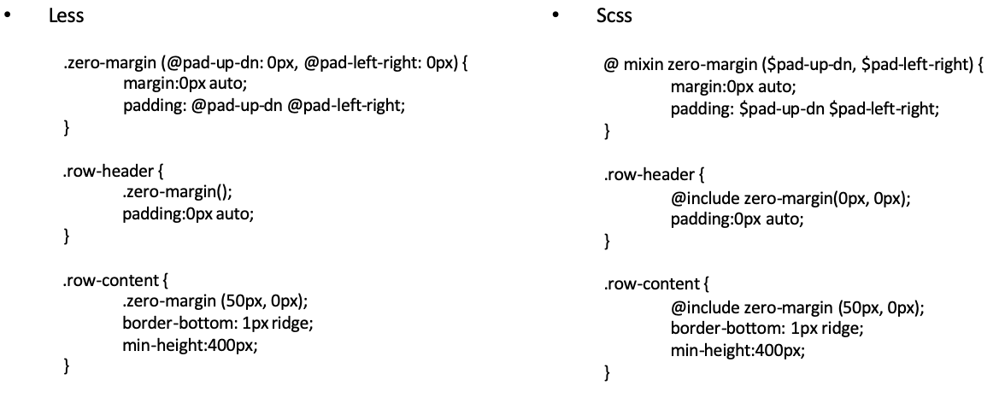
Mixins with Parameters

Slide 12
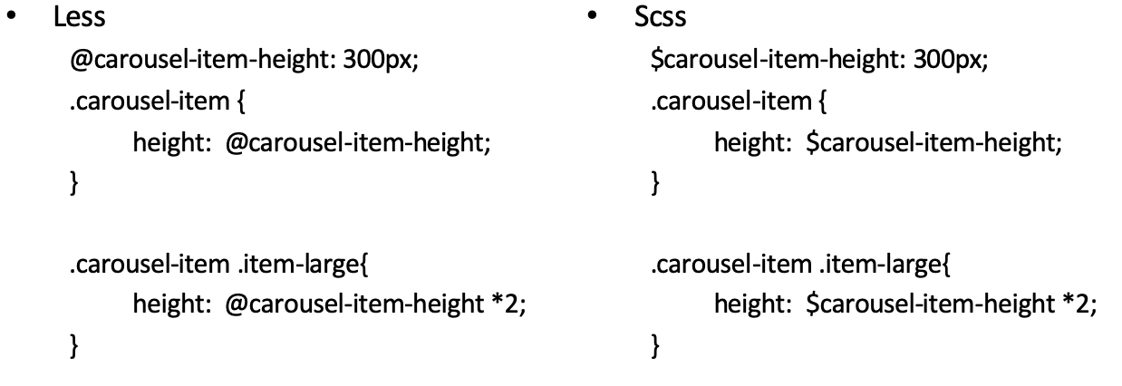
Mathematical Operations

Slide 13
Other Features
Functions: math, list, string, color, color operations, color blending etc.
See the documentation: https://sass-lang.com/guide
Imports
e.g., in both Less and Sass: @import “foo”

Slide 14
Exercise 15: Scss
Create a React app
Write Scss code using many of the features of Scss
Automatically convert the Scss code into CSS

Slide 15
Building and Deployment

Slide 16
Web Development and Deployment
Web development and deployment involves a lot of repetitive tasks
The DRY (do not repeat yourself) principle
Need for build tools to automate tasks

Slide 17
CSS Tasks
Compiling Sass or Less into CSS
Running Autoprefixer to add any vendor prefixes that are needed
Minification: removing unnecessary characters (white spaces, newlines, comments) from source code without compromising functionality
Concatenation

Slide 18
JavaScript Tasks
JSHint: Checking JavaScript code for errors and potential problems (static code analysis)
Concatenation
Uglification: minification + mangling (reduce local variables to single letters)
Rechecking for errors

Slide 19
Other Tasks
Images: optimizing files to reduce file size
Watch: watching for changes in files and automatically rerunning tasks
Server and Livereload
Testing
Building your site for deployment

Slide 20
NPM Scripts
“scripts” property in the package.json file:
Several supported
“start”: run by the npm start command
Of particular interest to us is to use the ”npm run” approach to run scripts
e.g., ”npm run scss”, “npm run lite”

Slide 21
Summary
Understand develop CSS code using preprocessors like Less and Sass

